Slide 1

Analysis of Algorithms
CS 477/677
Randomizing Quicksort
Instructor: George Bebis
(Appendix C.2 , Appendix C.3)
(Chapter 5, Chapter 7)

Slide 2
Randomizing Quicksort
Randomly permute the elements of the input array before sorting
OR ... modify the PARTITION procedure
  At each step of the algorithm we exchange element A[p] with an element chosen at random from A[p…r]
  The pivot element x = A[p] is equally likely to be any one of the r – p + 1 elements of the subarray

Slide 3
Randomized Algorithms
No input can elicit worst case behavior
  Worst case occurs only if we get “unlucky” numbers from the random number generator
Worst case becomes less likely
  Randomization can NOT eliminate the worst-case but it can make it less likely!

Slide 4
Randomized PARTITION
Alg.: RANDOMIZED-PARTITION(A, p, r)
i ← RANDOM(p, r)
exchange A[p] ↔ A[i]
return PARTITION(A, p, r)

Slide 5
Randomized Quicksort
Alg. : RANDOMIZED-QUICKSORT(A, p, r)
if p < r
then q ← RANDOMIZED-PARTITION(A, p, r)
RANDOMIZED-QUICKSORT(A, p, q)
RANDOMIZED-QUICKSORT(A, q + 1, r)

Slide 6
Formal Worst-Case
Analysis of Quicksort
T(n) = worst-case running time
T(n) = max (T(q) + T(n-q)) + Θ(n)
^{1 ≤ q ≤ n-1}
Use substitution method to show that the running time of Quicksort is O(n²)
Guess T(n) = O(n²)
  Induction goal: T(n) ≤ cn²
  Induction hypothesis: T(k) ≤ ck² for any k < n

Slide 7
Worst-Case Analysis of Quicksort
Proof of induction goal:
T(n) ≤ max (cq² + c(n-q)²) + Θ(n) =
^{1 ≤ q ≤ n-1}
= c ⋅ max (q² + (n-q)²) + Θ(n)
^{1 ≤ q ≤ n-1}
The expression q² + (n-q)² achieves a maximum over the range 1 ≤ q ≤ n-1 at one of the endpoints
max (q² + (n - q)²) = 1² + (n - 1)² = n² – 2(n – 1)
^{1 ≤ q ≤ n-1}
T(n) ≤ cn² – 2c(n – 1) + Θ(n)
≤ cn²

Slide 8
Revisit Partitioning
Hoare’s partition
  Select a pivot element x around which to partition
  Grows two regions
A[p…i] ≤ x
x ≤ A[j…r]
A[p…i] ≤ x
x ≤ A[j…r]
i
j

Slide 9
Another Way to PARTITION
(Lomuto’s partition – page 146)
A[p…i] ≤ x
A[i+1…j-1] > x
Given an array A, partition the
array into the following subarrays:
  A pivot element x = A[q]
  Subarray A[p..q-1] such that each element of A[p..q-1] is smaller than or equal to x (the pivot)
  Subarray A[q+1..r], such that each element of A[p..q+1] is strictly greater than x (the pivot)
The pivot element is not included in any of the two subarrays
p
i
i+1
j-1
j
r
unknown
pivot

Slide 10




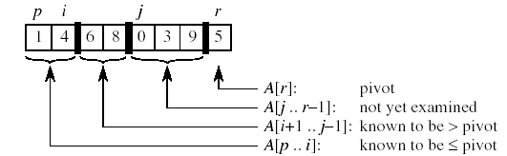




Example
at the end,
swap pivot

Slide 11
Another Way to PARTITION (cont’d)
Alg.: PARTITION(A, p, r)
  x ← A[r]
  i ← p - 1
  for j ← p to r - 1
  do if A[ j ] ≤ x
  then i ← i + 1
  exchange A[i] ↔ A[j]
  exchange A[i + 1] ↔ A[r]
  return i + 1
A[p…i] ≤ x
A[i+1…j-1] > x
p
i
i+1
j-1
j
r
unknown
pivot
Chooses the last element of the array as a pivot
Grows a subarray [p..i] of elements ≤ x
Grows a subarray [i+1..j-1] of elements >x
Running Time: Θ(n), where n=r-p+1

Slide 12
Randomized Quicksort
(using Lomuto’s partition)
Alg. : RANDOMIZED-QUICKSORT(A, p, r)
if p < r
then q ← RANDOMIZED-PARTITION(A, p, r)
RANDOMIZED-QUICKSORT(A, p, q - 1)
RANDOMIZED-QUICKSORT(A, q + 1, r)
The pivot is no longer included in any of the subarrays!!

Slide 13
Analysis of Randomized Quicksort
Alg. : RANDOMIZED-QUICKSORT(A, p, r)
if p < r
then q ← RANDOMIZED-PARTITION(A, p, r)
RANDOMIZED-QUICKSORT(A, p, q - 1)
RANDOMIZED-QUICKSORT(A, q + 1, r)
The running time of Quicksort is dominated by PARTITION !!
PARTITION is called at most n times
(at each call a pivot is selected and never again included in future calls)

Slide 14
PARTITION
Alg.: PARTITION(A, p, r)
  x ← A[r]
  i ← p - 1
  for j ← p to r - 1
  do if A[ j ] ≤ x
  then i ← i + 1
  exchange A[i] ↔ A[j]
  exchange A[i + 1] ↔ A[r]
  return i + 1
O(1) - constant
# of comparisons: X_{k}
between the pivot and
the other elements
O(1) - constant
Amount of work at call k: c + X_{k}

Slide 15
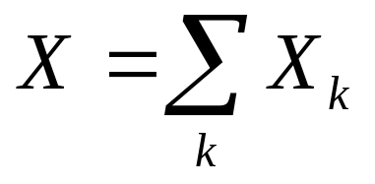
Average-Case Analysis of Quicksort
Let X = total number of comparisons performed in all calls to PARTITION:
The total work done over the entire execution of Quicksort is
O(nc+X)=O(n+X)
Need to estimate E(X)

Slide 16
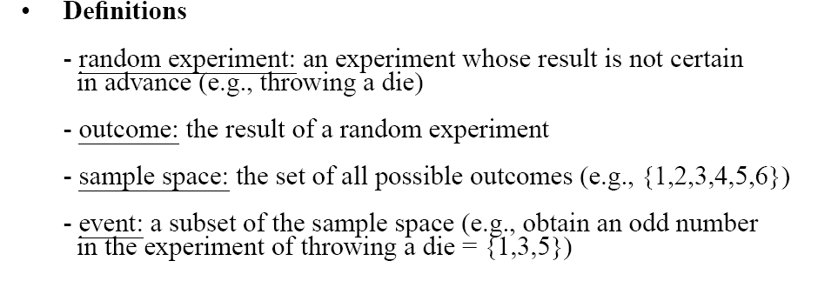
Review of Probabilities

Slide 17
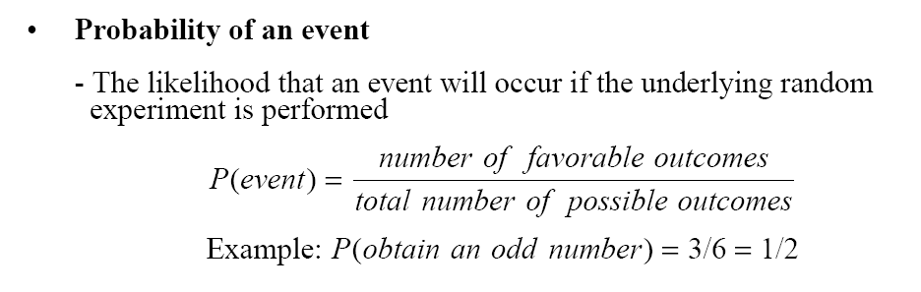
Review of Probabilities
(discrete case)

Slide 18
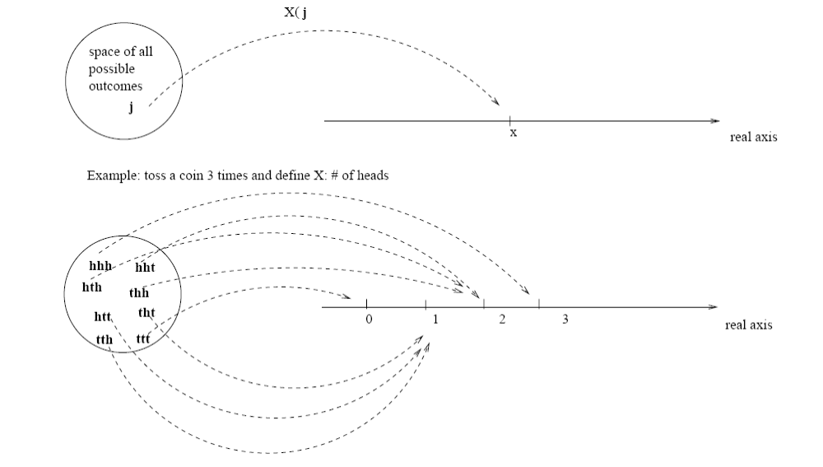
Random Variables
Def.: (Discrete) random variable X: a function from a sample space S to the real numbers.
  It associates a real number with each possible outcome of an experiment.
X(j)

Slide 19
Random Variables
E.g.: Toss a coin three times
define X = “numbers of heads”

Slide 20
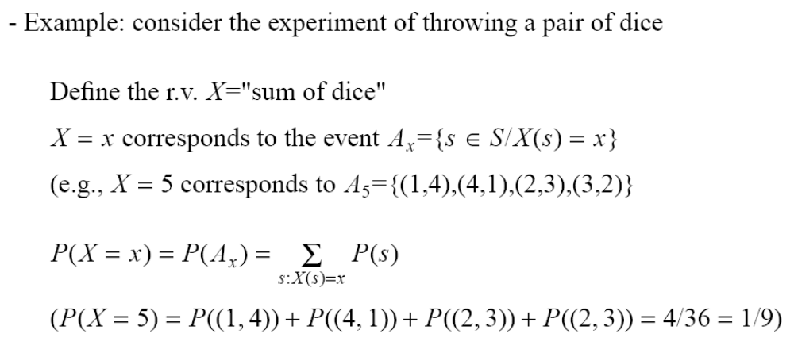
Computing Probabilities
Using Random Variables

Slide 21
Expectation
Expected value (expectation, mean) of a discrete random variable X is:
E[X] = Σ_{x} x Pr{X = x}
  “Average” over all possible values of random variable X

Slide 22
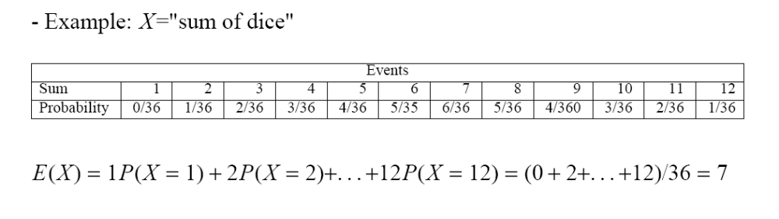
Examples
Example: X = face of one fair dice
  E[X] = 1⋅1/6 + 2⋅1/6 + 3⋅1/6 + 4⋅1/6 + 5⋅1/6 + 6⋅1/6 = 3.5
Example:

Slide 23
Indicator Random Variables
Given a sample space S and an event A, we define the indicator random variable I{A} associated with A:
  I{A} = 1 if A occurs
  0 if A does not occur
The expected value of an indicator random variable X_{A}=I{A} is:
E[X_{A}] = Pr {A}
Proof:
E[X_{A}] = E[I{A}] =
1 ∗ Pr{A} + 0 ∗ Pr{Ā}
= Pr{A}

Slide 24
Average-Case Analysis of Quicksort
Let X = total number of comparisons performed in all calls to PARTITION:
The total work done over the entire execution of Quicksort is
O(n+X)
Need to estimate E(X)

Slide 25
Notation
z₂
z₉
z₈
z₃
z₅
z₄
z₁
z₆
z₁₀
z₇
2
9
8
3
5
4
1
6
10
7
Rename the elements of A as z₁, z₂, . . . , z_{n}, with z_{i} being the i-th smallest element
Define the set Z_{ij} = {z_{i} , z_{i+1}, . . . , z_{j} } the set of elements between z_{i} and z_{j}, inclusive

Slide 26
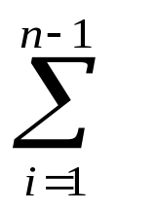
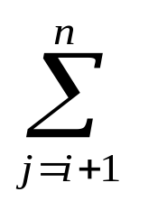

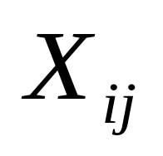
Total Number of Comparisons in PARTITION
Define X_{ij} = I {z_{i} is compared to z_{j} }
Total number of comparisons X performed by the algorithm:
i
n-1
i+1
n

Slide 27
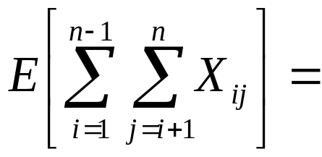
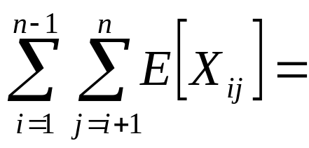
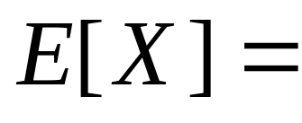
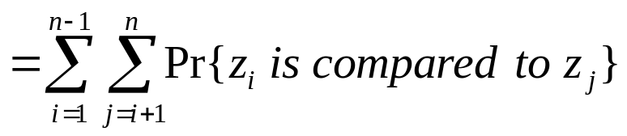
Expected Number of Total Comparisons in PARTITION
Compute the expected value of X:
by linearity
of expectation
indicator
random variable
the expectation of X_{ij} is equal to the probability of the event “z_{i} is compared to z_{j}”

Slide 28
Comparisons in PARTITION : Observation 1
Each pair of elements is compared at most once during the entire execution of the algorithm
  Elements are compared only to the pivot point!
  Pivot point is excluded from future calls to PARTITION

Slide 29
Comparisons in PARTITION:
Observation 2
Only the pivot is compared with elements in both partitions!
z₂
z₉
z₈
z₃
z₅
z₄
z₁
z₆
z₁₀
z₇
2
9
8
3
5
4
1
6
10
7
Z_{1,6}= {1, 2, 3, 4, 5, 6}
{7}
Z_{8,9} = {8, 9, 10}
pivot
Elements between different partitions
are never compared!

Slide 30
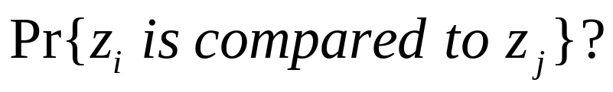
Comparisons in PARTITION
z₂
z₉
z₈
z₃
z₅
z₄
z₁
z₆
z₁₀
z₇
2
9
8
3
5
4
1
6
10
7
Z_{1,6}= {1, 2, 3, 4, 5, 6}
{7}
Z_{8,9} = {8, 9, 10}
Case 1: pivot chosen such as: z_{i} < x < z_{j}
  z_{i} and z_{j} will never be compared
Case 2: z_{i} or z_{j} is the pivot
  z_{i} and z_{j} will be compared
  only if one of them is chosen as pivot before any other element in range z_{i} to z_{j}

Slide 31
See why ☺
z2 will never be
compared with z6
since z5 (which
belongs to [z₂, z₆])
was chosen as a
pivot first !
z₂ z₄ z₁ z₃ z₅ z₇ z₉ z₆

Slide 32
Probability of comparing z_{i} with z_{j}
Pr{
z_{i} is compared to z_{j}
}
=
Pr{
z_{i} is the first pivot chosen from Z_{ij}
}
+
OR
Pr{
z_{j} is the first pivot chosen from Z_{ij}
}
  = 1/( j - i + 1) + 1/( j - i + 1) = 2/( j - i + 1)
There are j – i + 1 elements between z_{i} and z_{j}
  Pivot is chosen randomly and independently
  The probability that any particular element is the first one chosen is 1/( j - i + 1)

Slide 33
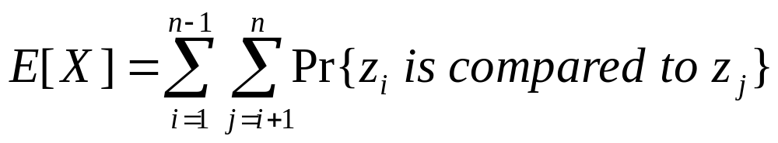
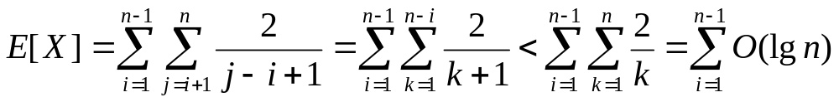
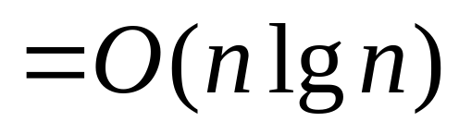
Number of Comparisons in PARTITION
Expected number of comparisons in PARTITION:
(set k=j-i)
(harmonic series)
⇒ Expected running time of Quicksort using RANDOMIZED-PARTITION is O(nlgn)

Slide 34
Alternative Average-Case
Analysis of Quicksort
See Problem 7-2, page 16
Focus on the expected running time of
each individual recursive call to Quicksort,
rather than on the number of comparisons
performed.
Use Hoare partition in our analysis.

Slide 35
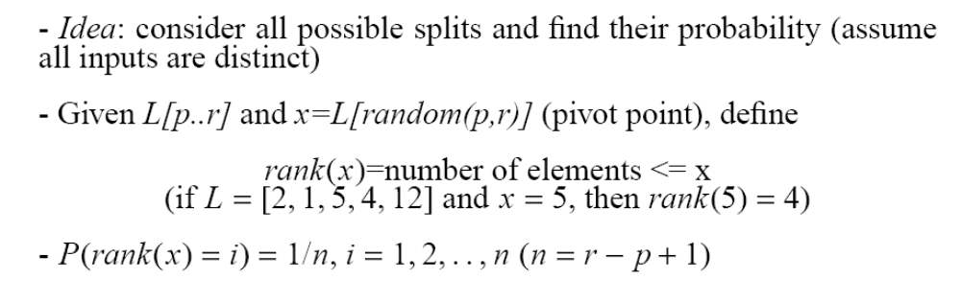
Alternative Average-Case
Analysis of Quicksort
(i.e., any element has the same probability to be chosen as pivot)

Slide 36
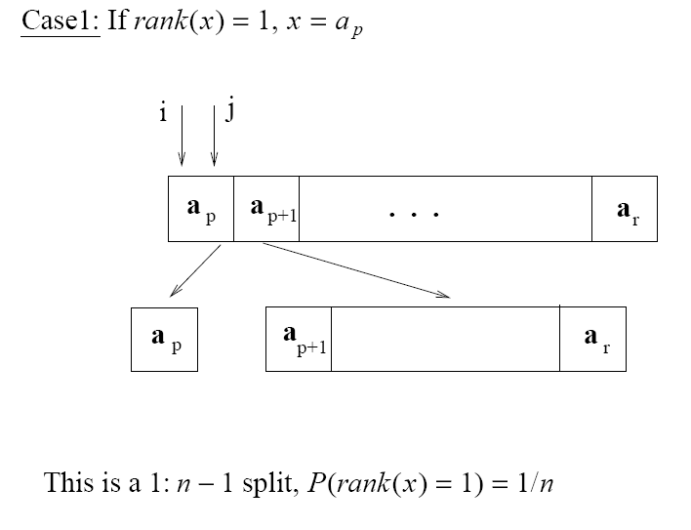
Alternative Average-Case
Analysis of Quicksort

Slide 37
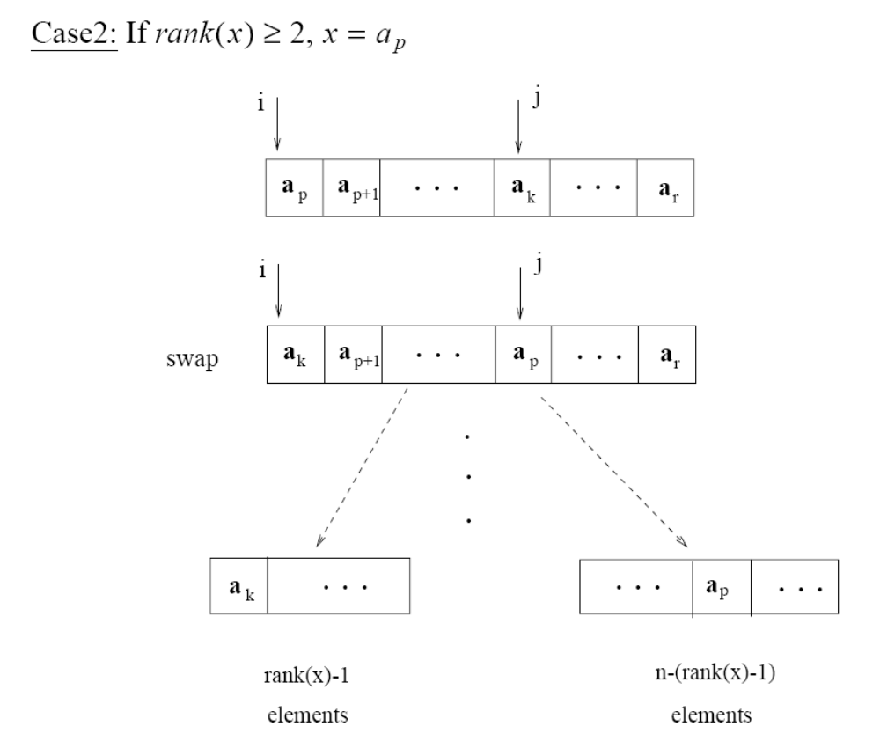
Alternative Average-Case
Analysis of Quicksort

Slide 38
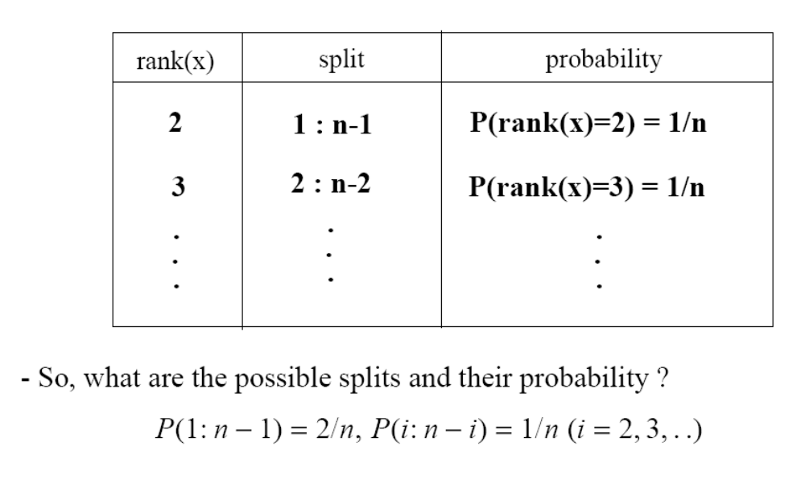
Alternative Average-Case
Analysis of Quicksort

Slide 39
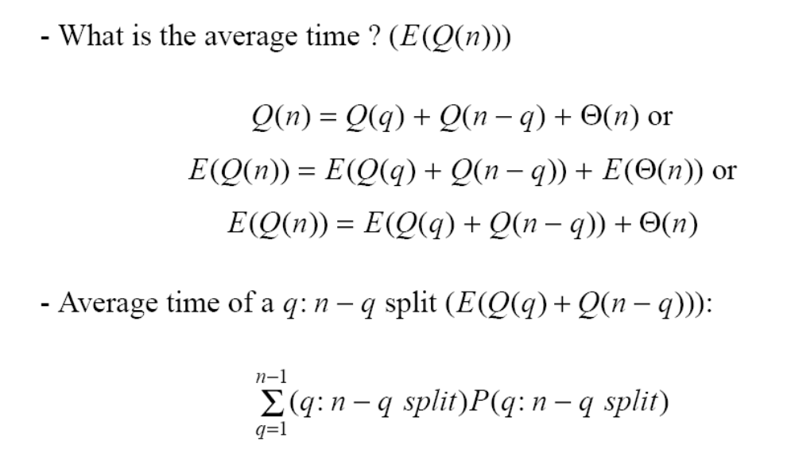
Alternative Average-Case
Analysis of Quicksort
- 1:n-1 splits have 2/n probability
- all other splits have 1/n probability

Slide 40
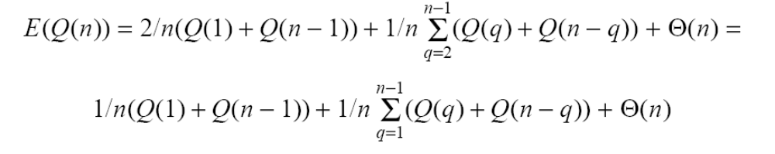
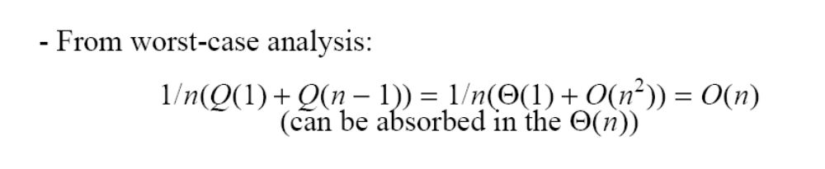
Alternative Average-Case
Analysis of Quicksort

Slide 41
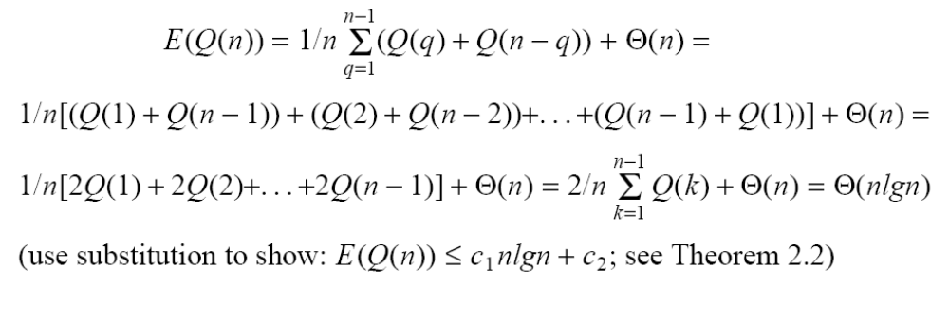

Alternative Average-Case
Analysis of Quicksort
recurrence for average case: Q(n) =

Slide 42
Problem
Consider the problem of determining whether an arbitrary sequence {x₁, x₂, ..., x_{n}} of n numbers contains repeated occurrences of some number. Show that this can be done in Θ(nlgn) time.
  Sort the numbers
    Θ(nlgn)
  Scan the sorted sequence from left to right, checking whether two successive elements are the same
    Θ(n)
  Total
    Θ(nlgn)+Θ(n)=Θ(nlgn)

Slide 43

Ex 2.3-6 (page 37)
Can we use Binary Search to improve InsertionSort (i.e., find the correct location to insert A[j]?)
Alg.: INSERTION-SORT(A)
for j ← 2 to n
do key ← A[ j ]
Insert A[ j ] into the sorted sequence A[1 . . j -1]
i ← j - 1
while i > 0 and A[i] > key
do A[i + 1] ← A[i]
i ← i – 1
A[i + 1] ← key

Slide 44
Ex 2.3-6 (page 37)
Can we use binary search to improve InsertionSort (i.e., find the correct location to insert A[j]?)
  This idea can reduce the number of comparisons from O(n) to O(lgn)
  Number of shifts stays the same, i.e., O(n)
  Overall, time stays the same ...
  Worthwhile idea when comparisons are expensive (e.g., compare strings)

Slide 45
Problem
Analyze the complexity of the following function:
F(i)
if i=0
then return 1
return (2*F(i-1))
Recurrence: T(n)=T(n-1)+c
Use iteration to solve it .... T(n)=Θ(n)

Slide 46
Problem
What is the running time of Quicksort when all the elements are the same?
  Using Hoare partition → best case
    Split in half every time
    T(n)=2T(n/2)+n → T(n)=Θ(nlgn)
  Using Lomuto’s partition → worst case
    1:n-1 splits every time
    T(n)=Θ(n²)

